Slide 1
SMARTMET Training
Module 7 : IT Competency
Lesson 1: Information
Security Part 1

Slide 2
Outline
Todays information Security
What are the Security Objectives
Data breaches
Risk Analysis
Security controls
Data Protection
Image by kjpargeter on Freepik

Slide 3
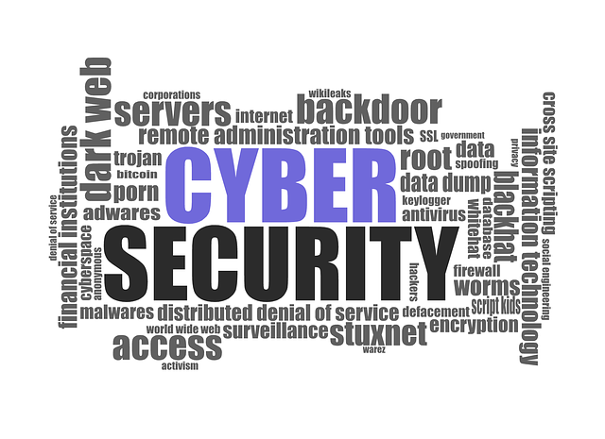
Todays Information Security
Information Security – keeping information assets protected
Increased ICT Landscape
Proliferation of user devices
BYOD, CYOD
Cloud Services
AI applications
Risk Management
Increased threat vectors
Increased threat actors
IT Security professionals upskilling
Staying ahead

Slide 4
Security Primitives
3 objectives
Confidentiality – keeping things secret
Integrity – quality of data
Availability – having access when needed
CIA Triad
One security model, there are many
McCumber Cube
Cybersecurity Mature Model

Slide 5
Security Primitives
DAD Triad – comparative model to CIA
3 threats
Disclosure – unauthorized access
Data loss
Data exfiltration
Alteration – unauthorized change
Denial – authorsied users unable to access systems/information
Denial of service (DDOS)
Linkages

Slide 6
Data Breach
Security Incidents
CIA compromised
Can be at least one, two or all
Perpetuated by threat actors
3 states of information
Rest
transmitted
processed
Impact of breaches
what is the impact?
how big is the impact?
how wide it reaches?

Slide 7
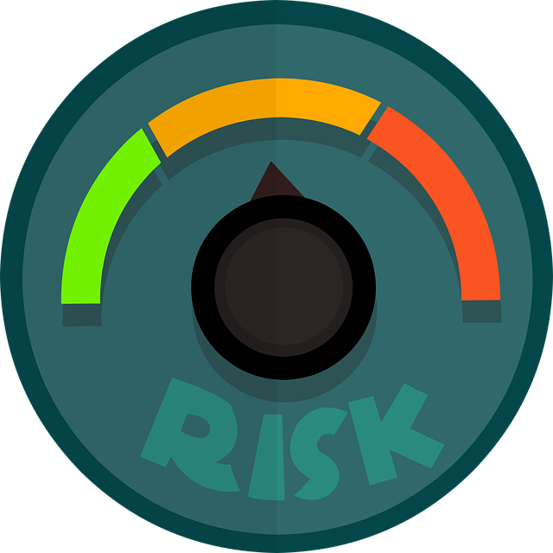
Risk Analysis
To protect we need to analyse the risks
What is our desired security state
Risk categories
Financial – monetary damage
Reputational – organisations image and public perception
Strategic – achieving organisational goals and objectives
Operational – day-to-day functions
Compliance – legal and regulatory requirements

Slide 8
Data Protection
Organisational and customer data entrusted to us to protect
Data protection techniques – consider the 3 states where data exists
Data Encryption – uses mathematical algorithms on data in transit and on storage
Data Loss prevention – enforce information policies to prevent data loss and theft
Host-based – e.g. use of clients and agents on hosts
Network-based – monitors network traffic
Data Minimization – reduce amount of information maintained on a regular basis
Methods used
Destroy
De-identification
Data Obfuscation e.g. hashing, tokenization, masking

Slide 9
Security Controls
Determine the type of controls
Cost benefit analysis
Is it worth it? Does the impact of the breach outweigh the cost of the control?
Alternatives?
Security control categories
Technical – digital enforcement e.g. firewall, access control lists (ACLs)
Operational – processes to manage technology e.g. monitoring access, logs
Managerial – procedures focused on risk management e.g. annual risk assessments, change management

Slide 10
Security Controls
Security control types – security base on desired effect
Preventative – intend to stop security issue before it occurs
Detective – identify security event already occurred
Corrective – remediate security issue
Deterrent – prevent an attack
Physical – security controls on the physical world
Compensating – mitigate the risk associated with exceptions

Slide 11
Summary
Information/cybersecurity professionals are responsible for ensuring the security primitives of CIA is maintained
Data must be protected in transit, at rest, and in use
Data breaches have significant and diverse impacts on organisations
Security controls may be categorized based on their mechanism of action and intent
Best approach is to perform a risk analysis and then have multiple and overlapping controls or layers in place to address the risks
Reference List
CIS Security
ISO 27000
NIST
Sybex Comptia Security+ Guide

